Slide 1
Graphen und Netzwerkalgorithmen
Lukas Holländer, Christian Geckeler, Jan Splett, Amadäus Spallek
WS 2017/2018 26.02.2018

Slide 2
Overview
Task Description
Program changes
Comparative series

Slide 3
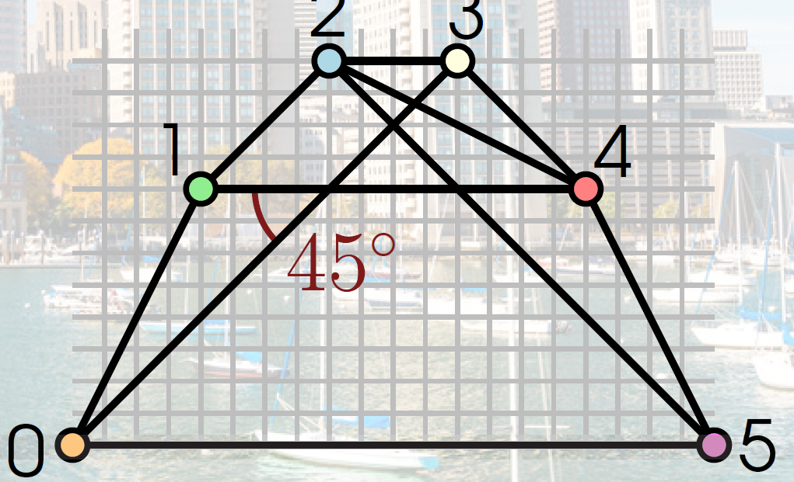
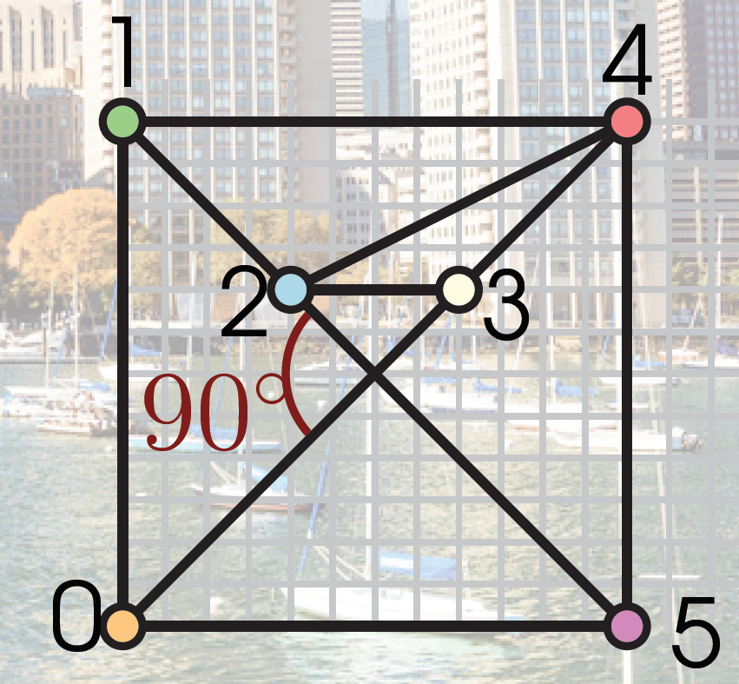
Task Description
Improve the results from the last contest
Problem to solve: Crossing Angle Maximization
Input: arbitrary graph
Output: straight-line embedding with integer vertex coordinates
Objective: maximize the smallest angle between any crossing edges

Slide 4
Feature of the initial Program
Sidebar
Force algorithm
Genetic algorithm
Menu Bar
Multiple layout function in yFiles Layout and Layout
Gridding was only a simple round function without output

Slide 5
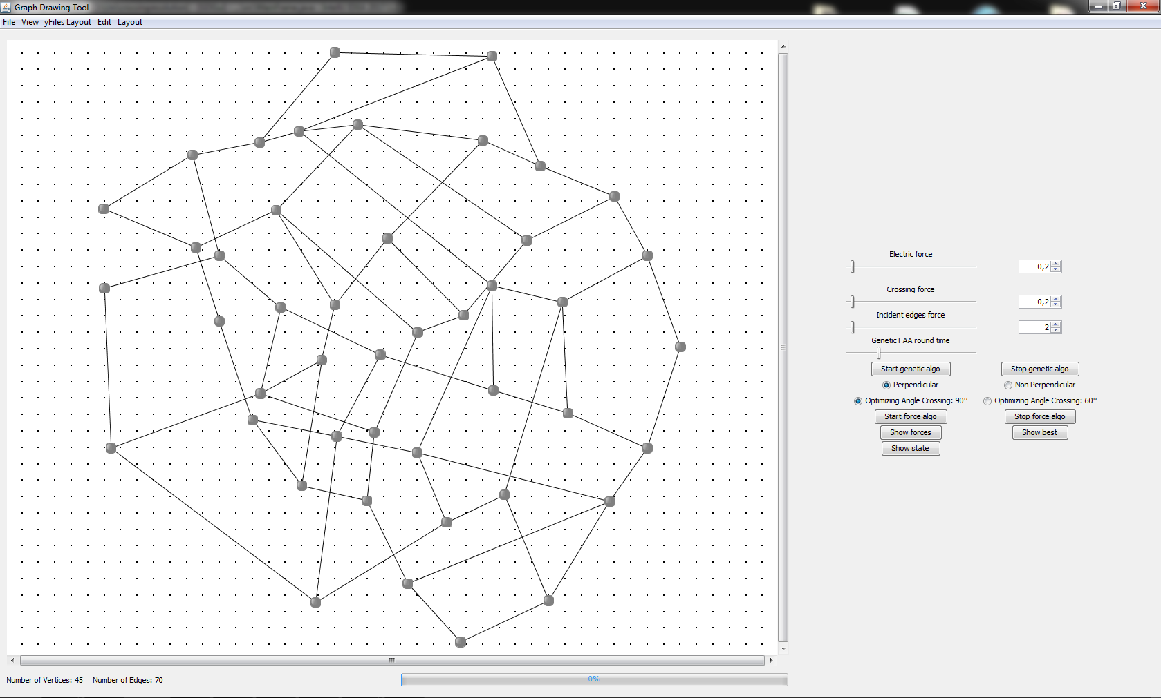
UI of the initial Program
Force -> slope force zusätzlich, Genetic
Improved UI
Griding war nur runden (ohne ausgabe)

Slide 6
Functional improvements
Random Movement
Slope force, an addition for the force algorithm
Clinch Nodes
Gridding algorithm, improved gridding
Fraysseix-Pach-Pollack algorithm
Remove and reinsert nodes
Remove and reinsert chains
Now its easy to add new algorithms

Slide 7
Usability improvements
New sidebar
All algorithm's parameters configurable on the fly
Output box, Graph info
Show minimum Angle
Manual Mode
Show best
Parallel runs

Slide 8
Codebase Changes
Refactored and Cleaner Code
Readme

Slide 9
Add new algorithms
Requires three things:
The logic of the algorithm
layout.algo.execution.ILayout
Set of parameters
layout.algo.layoutinterface.Iconfigurator
Adding in the view
sidepanel.InitSidePanel#initSidePanel()
More in the readme

Slide 10
Random Movement
For each iteration
Selects a node at random
Creates a number of random sample locations
Selects one at random that does not hurt the minimum angle

Slide 11
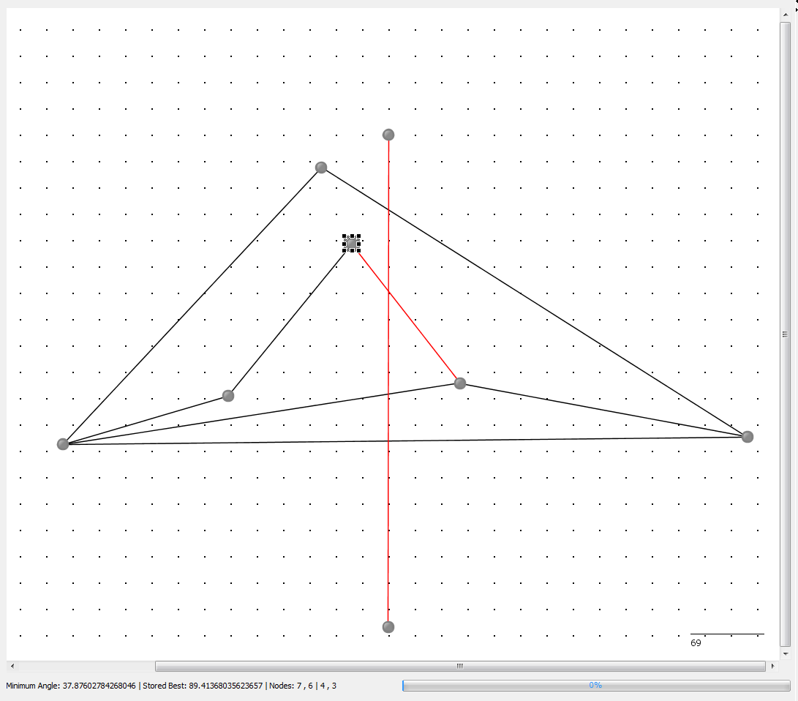
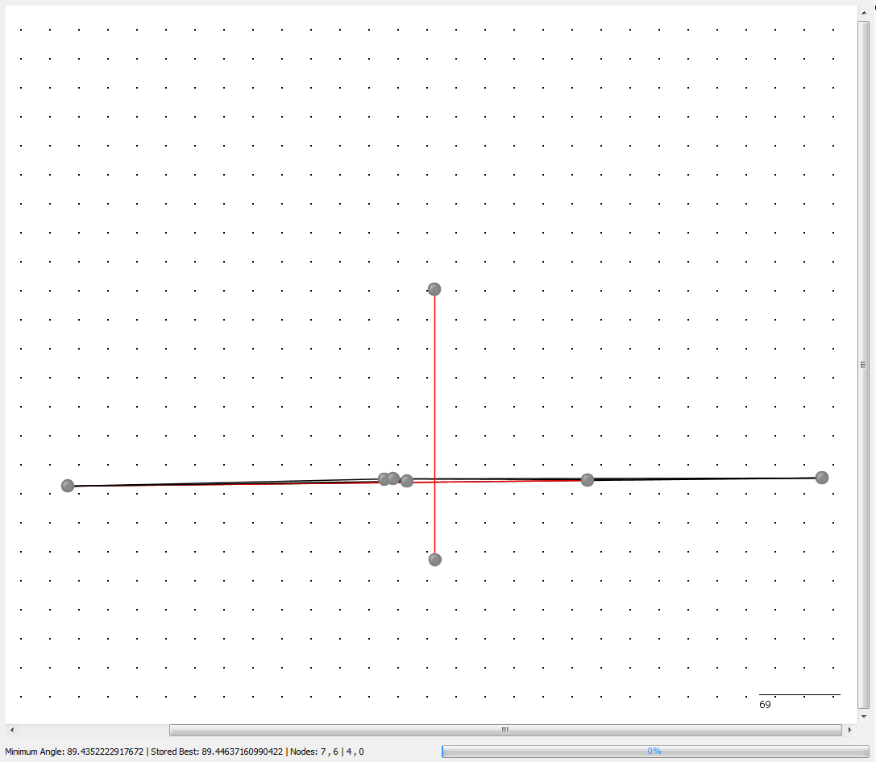
Clinch Nodes
Before clinching 37.88°
After clinching 89.44°

Slide 12
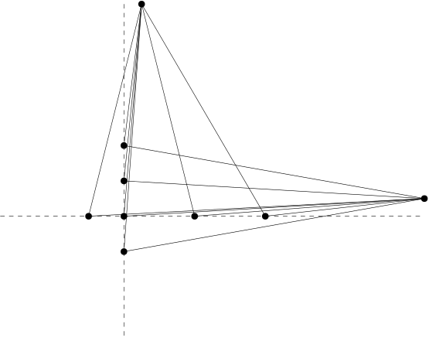
High Degree Nodes with two Axes
Goal: crossing angle near 90°
Find high degree nodes
Determine corresponding axis
Move them out along the axis
Without overlapping

Slide 13
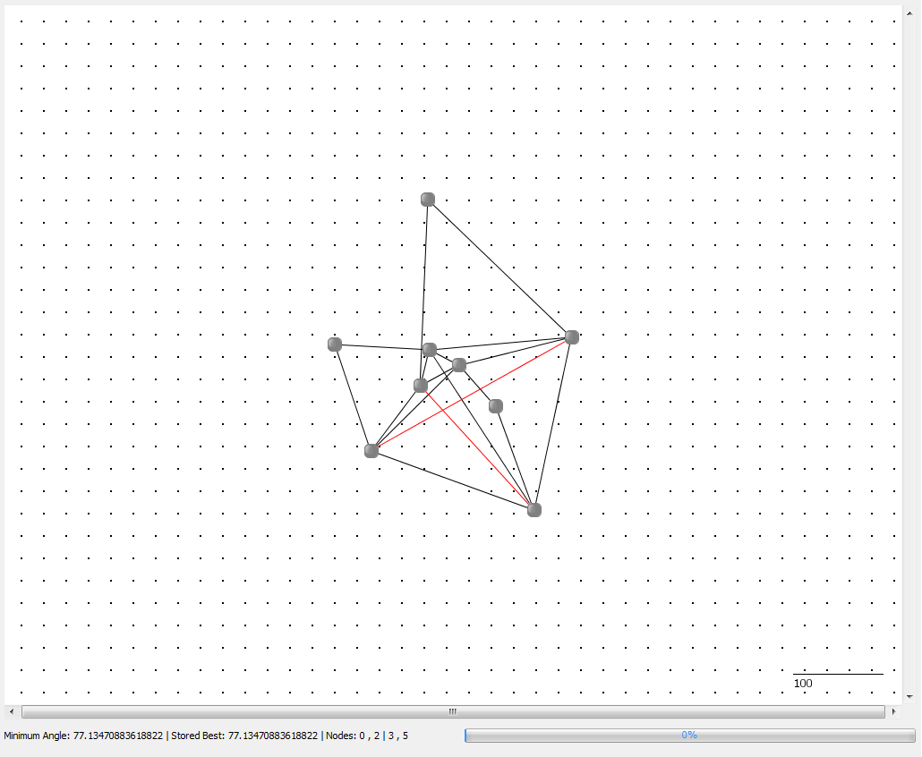
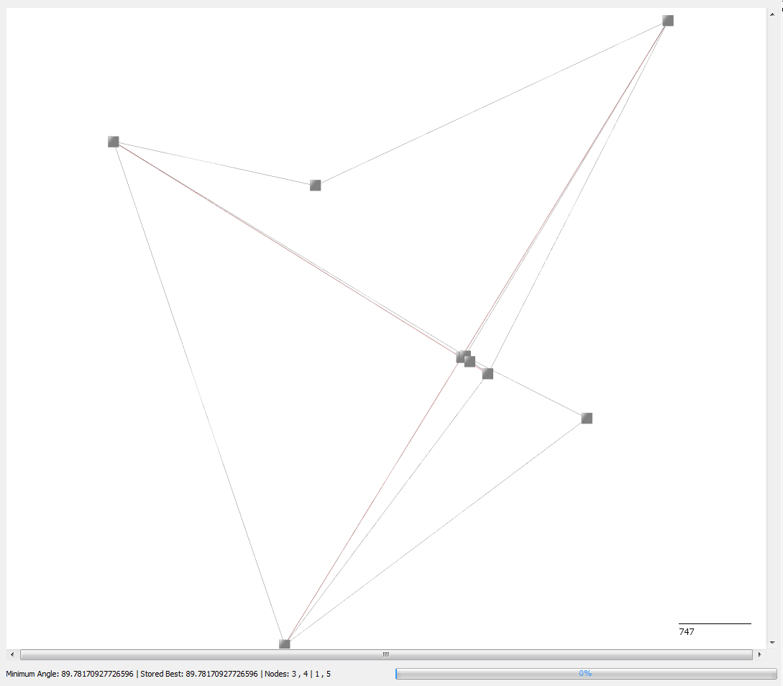
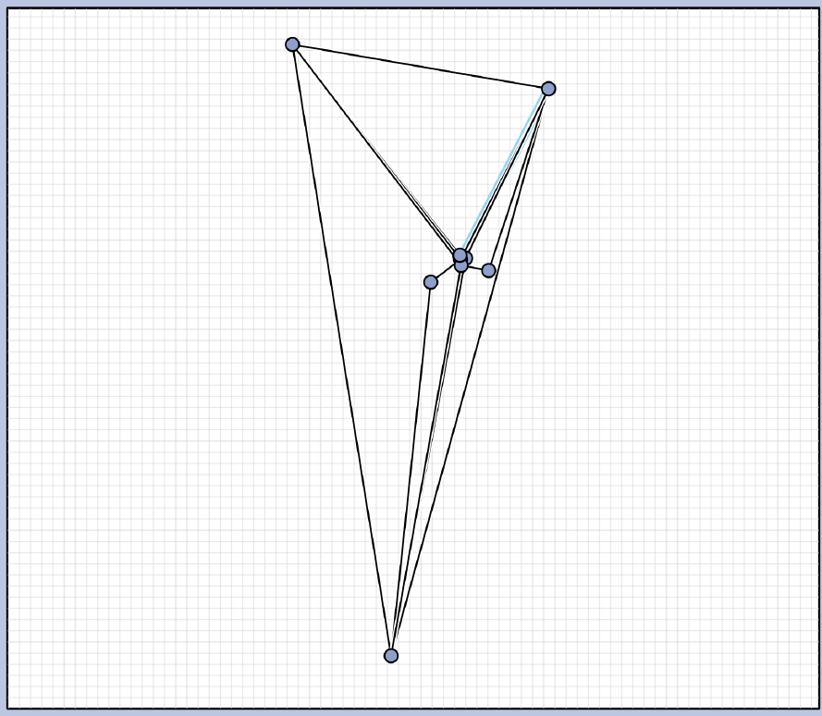
Graph 1
Current best 89.78°
Contest best last year 90°

Slide 14
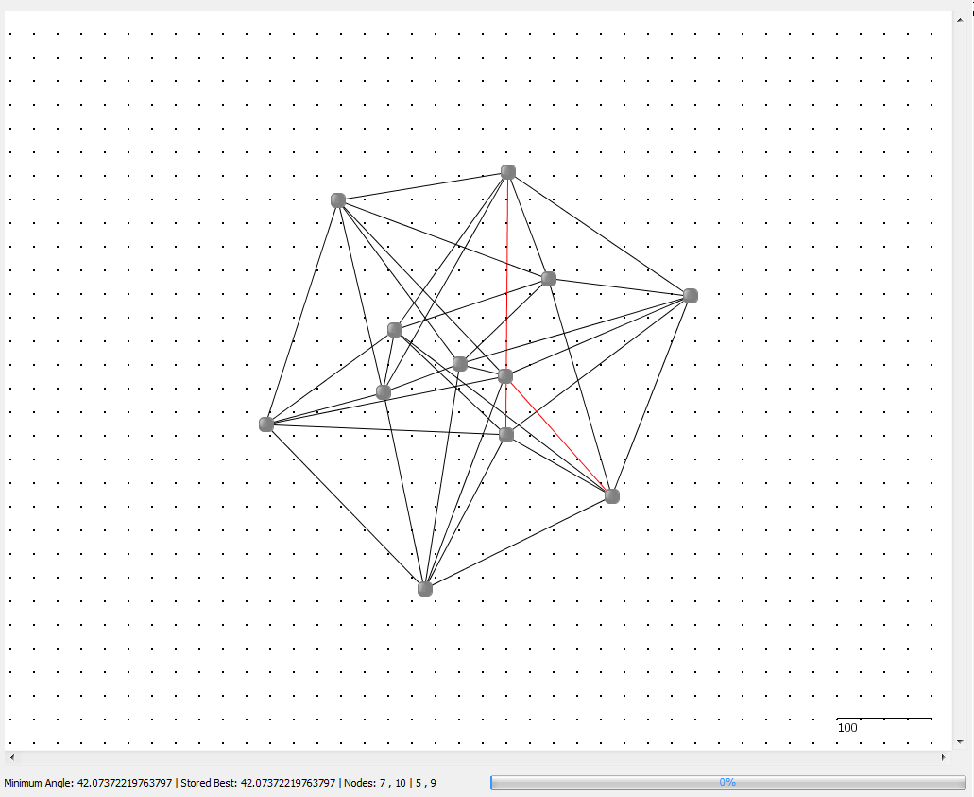
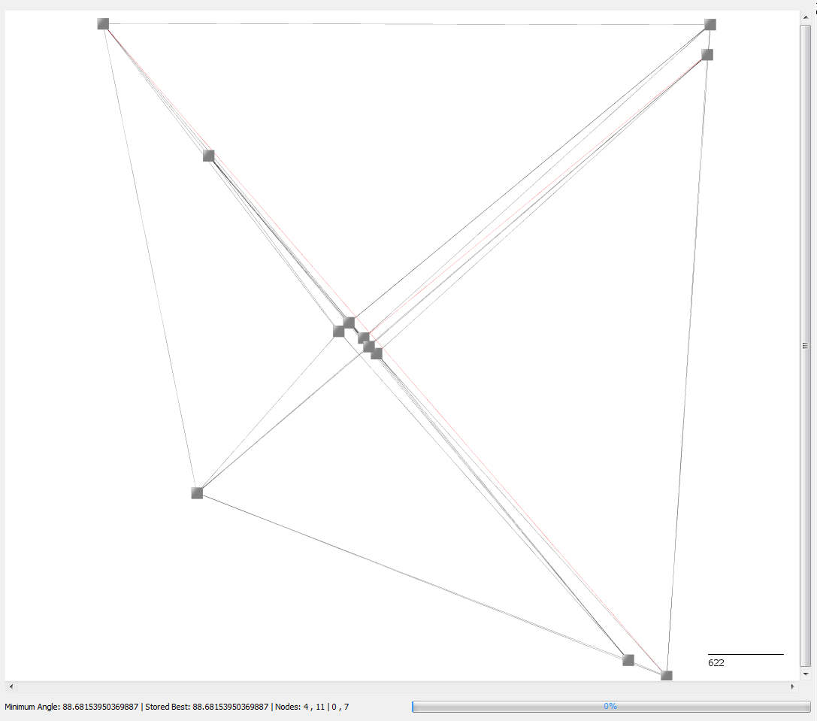
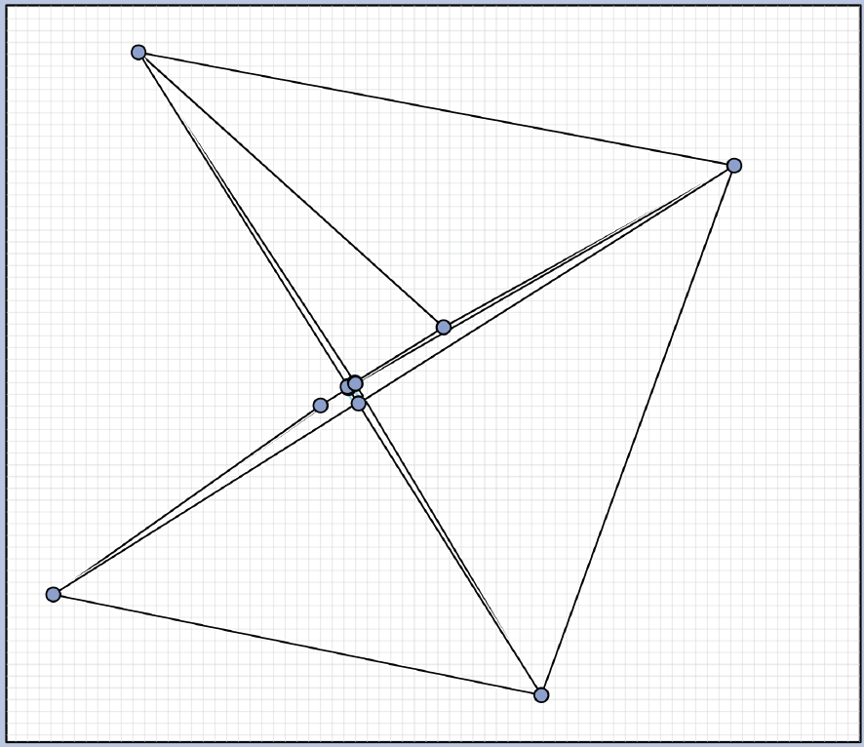
Graph 2
Current best 88.7°
Contest best last year 88.23°

Slide 15
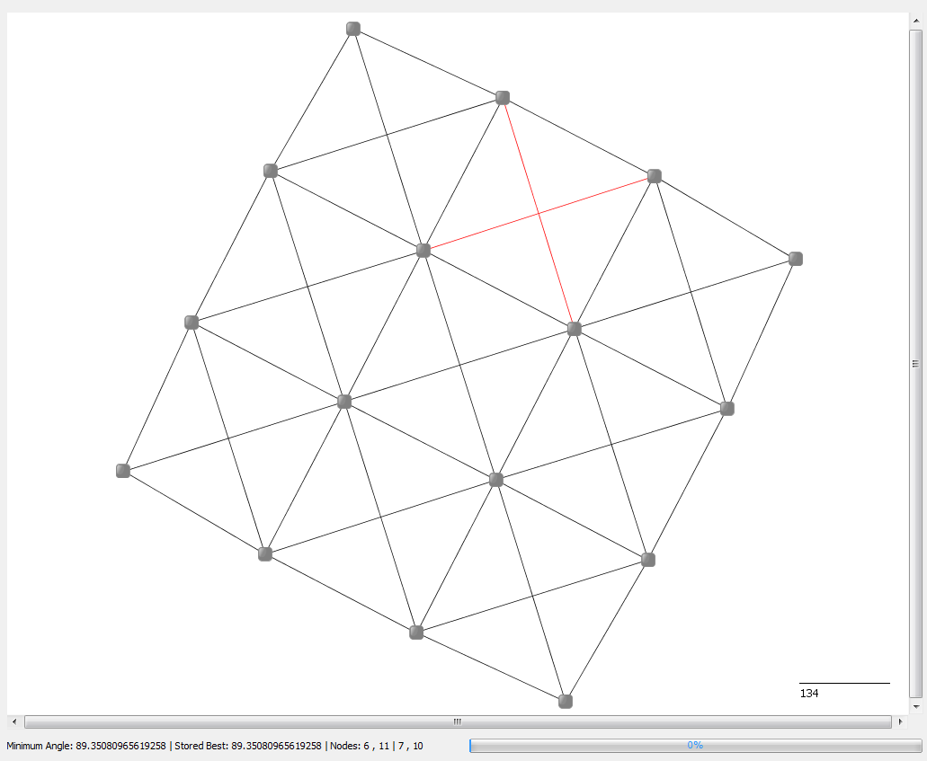
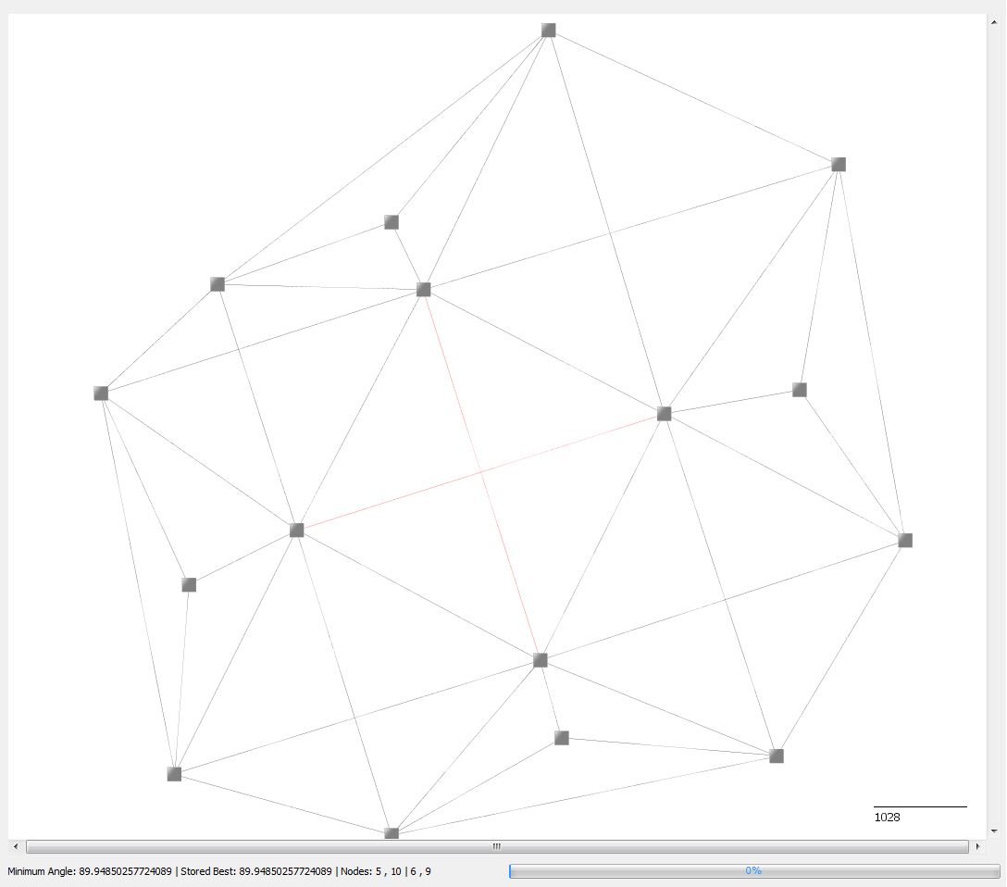
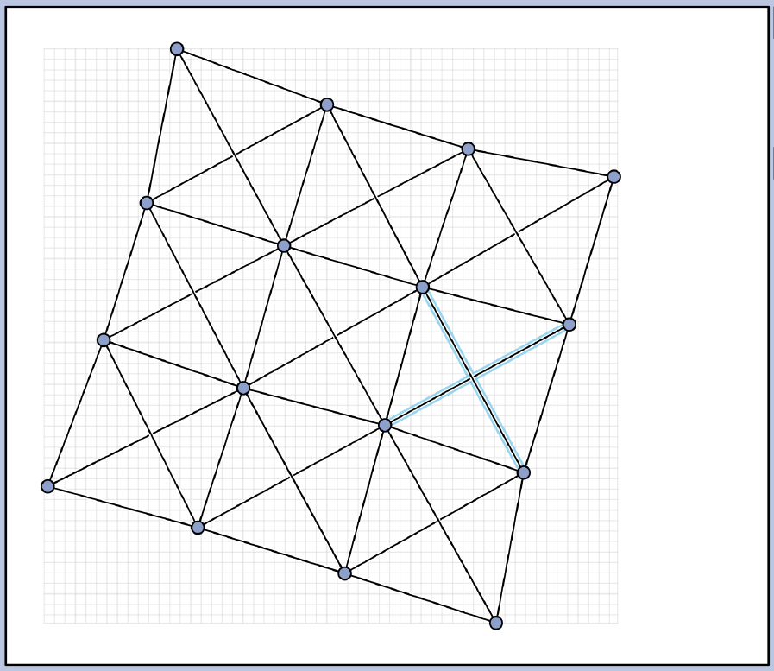
Graph 3
Current best 89.95°
Contest best last year 90°

Slide 16
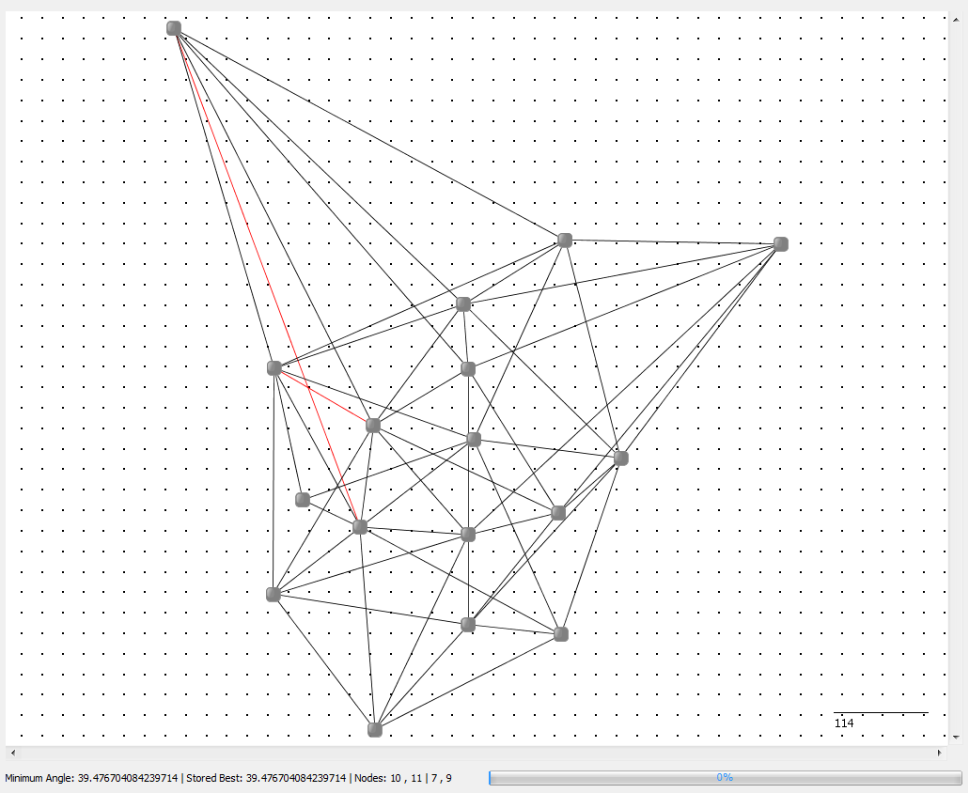
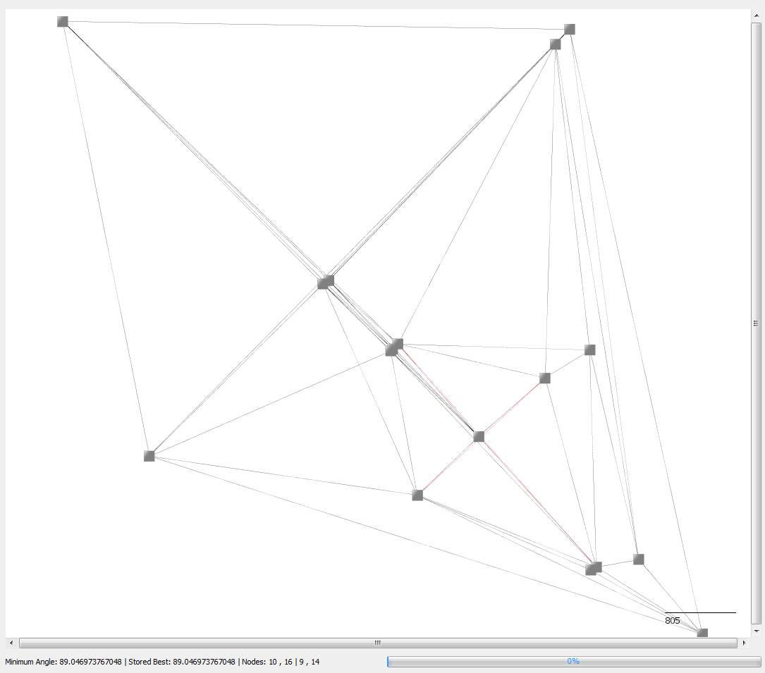
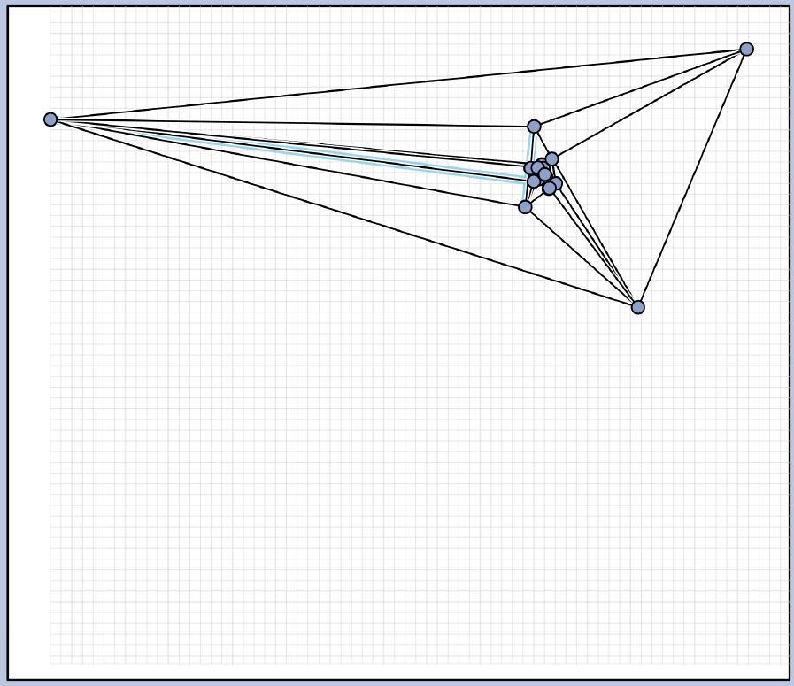
Graph 4
Current best 89.05°
Contest best last year 88.97°

Slide 17
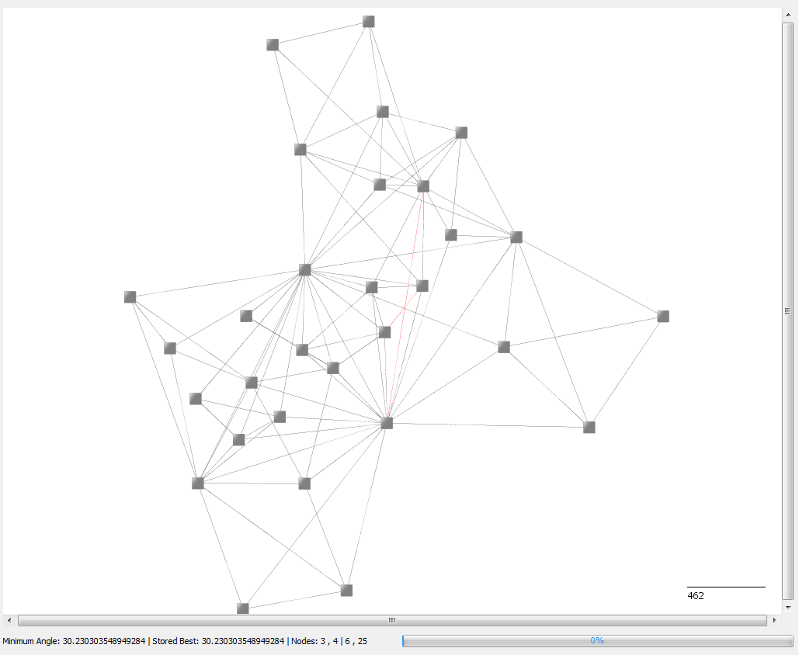
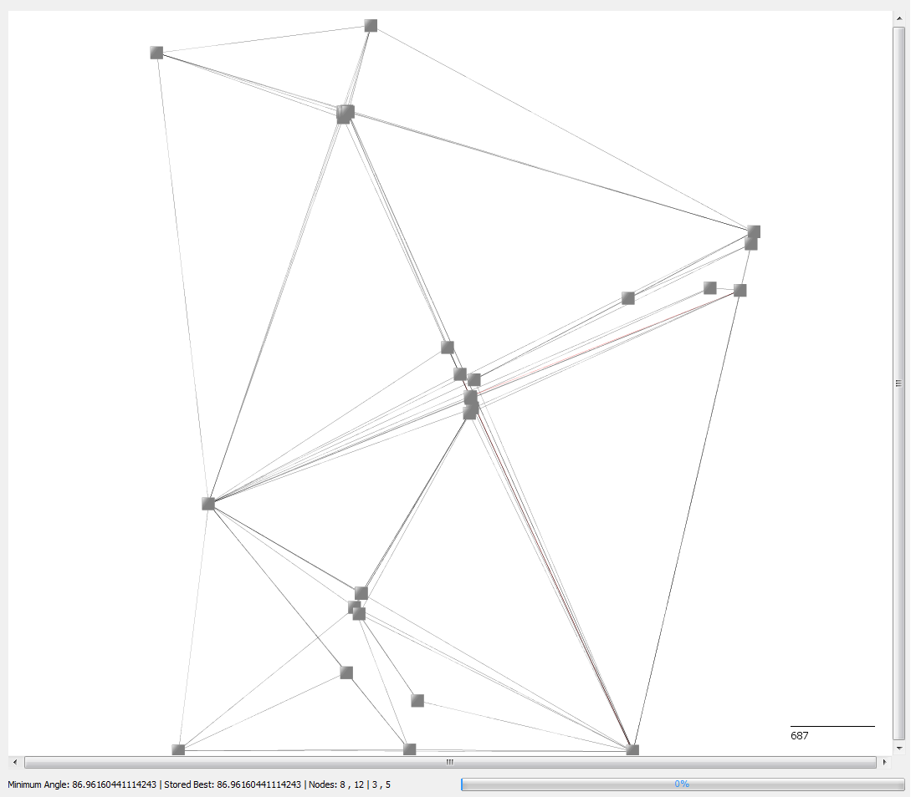
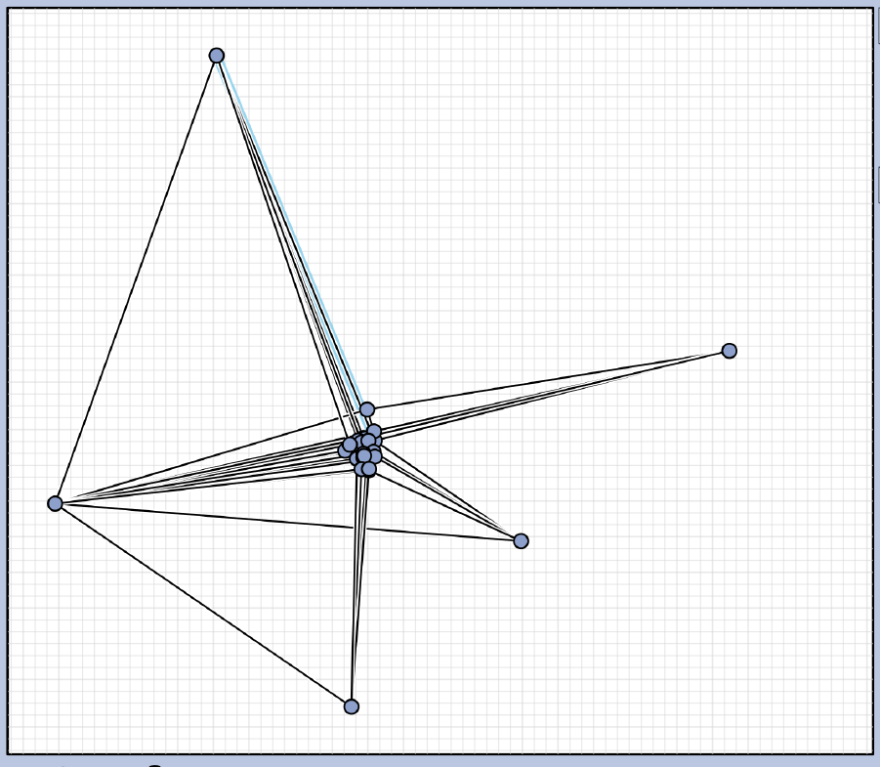
Graph 5
Current best 86.96°
Contest best last year 80.4°

Slide 18
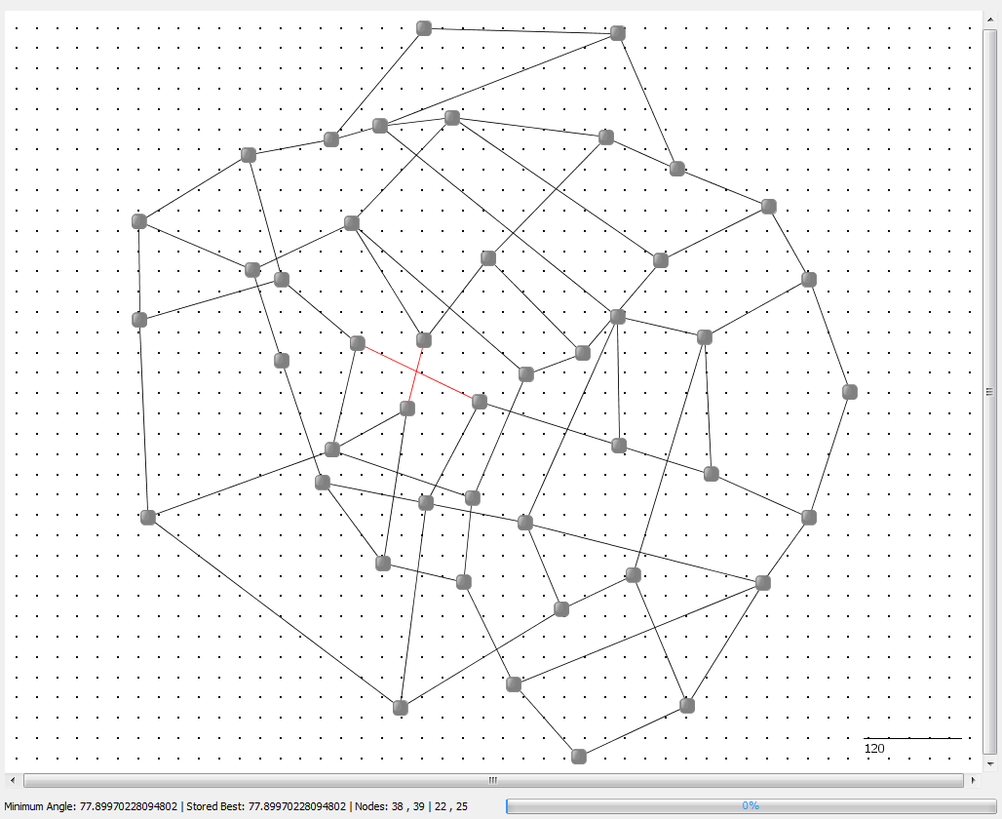
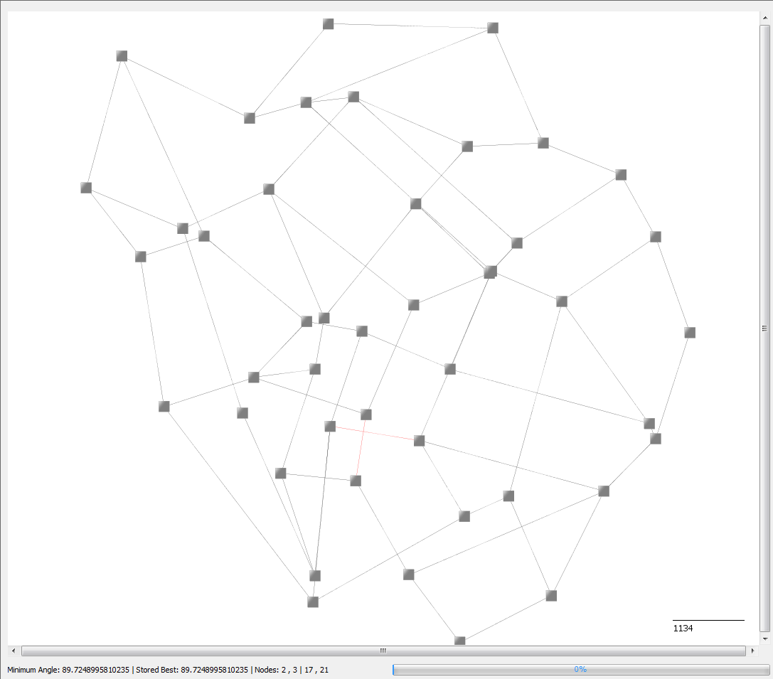
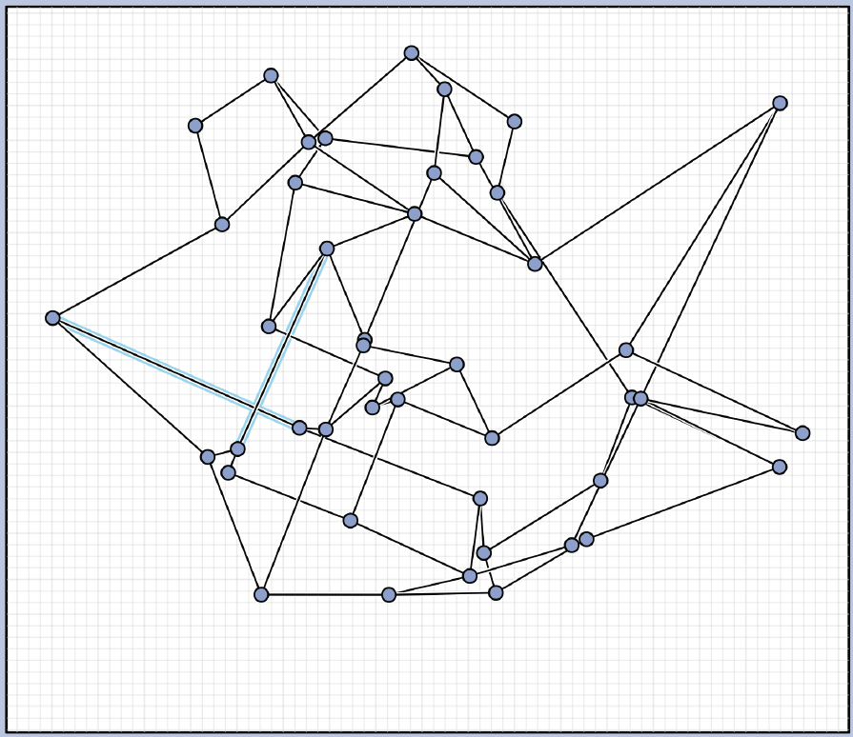
Graph 6
Current best 89.72°
Contest best last year 90°

Slide 19
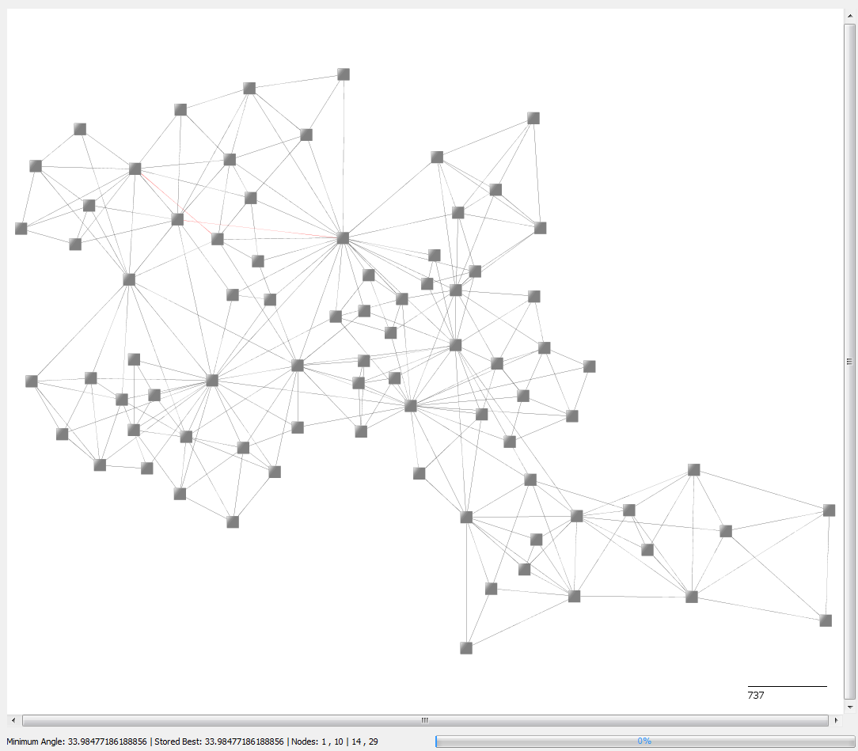
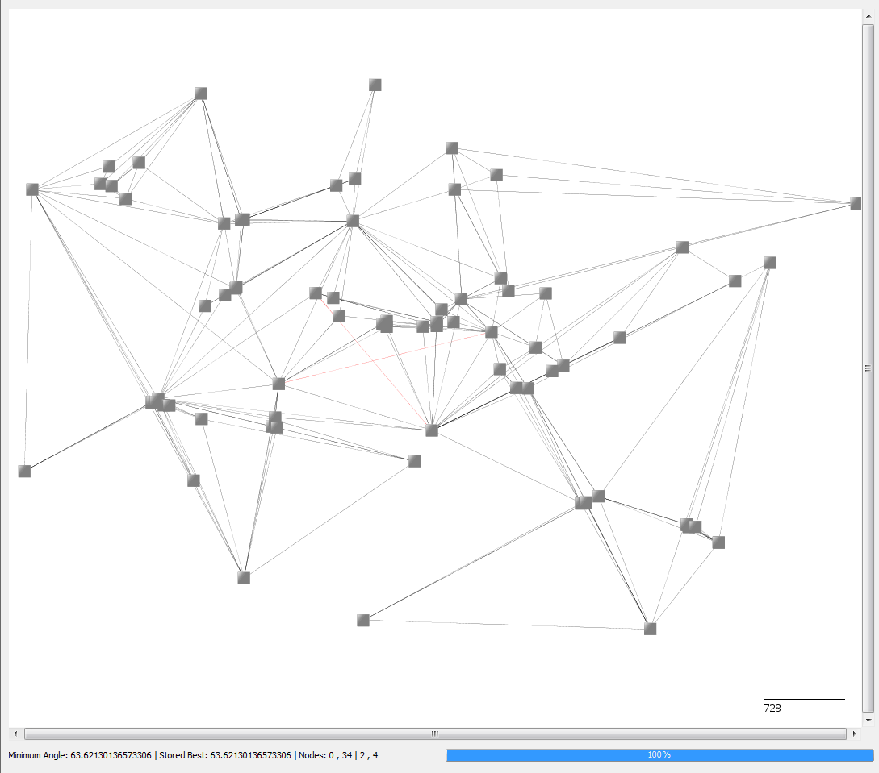
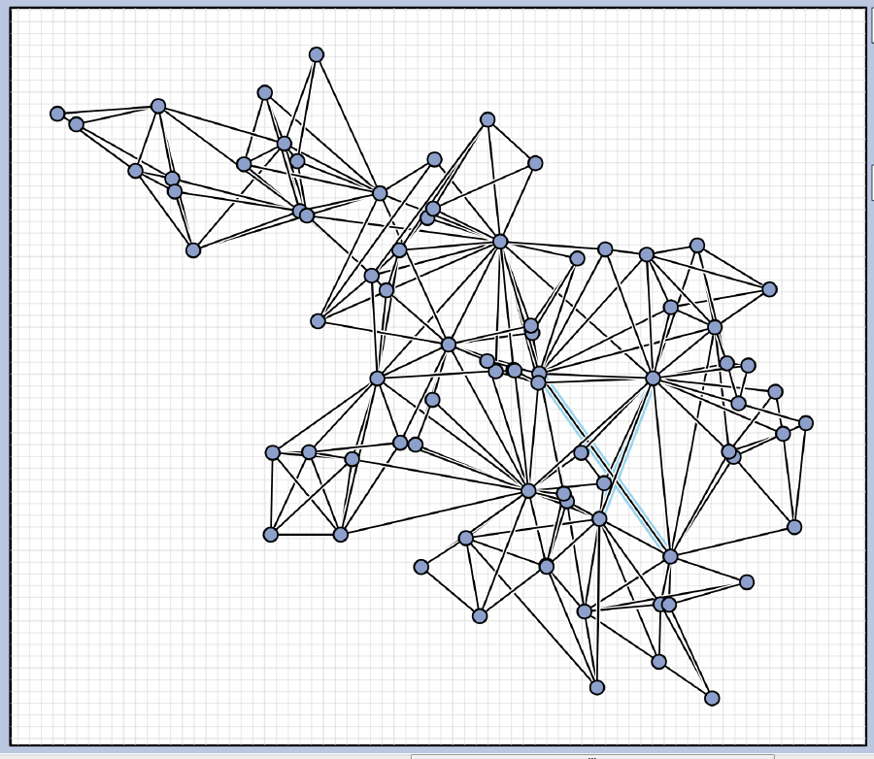
Graph 7
Current best 63.62°
Contest best last year 56.537°

Slide 20
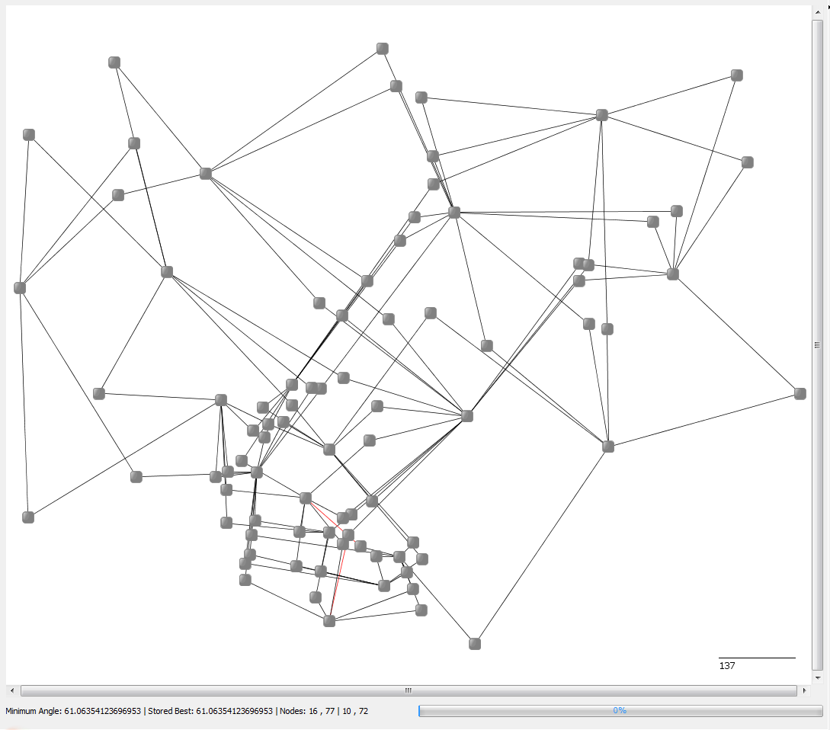
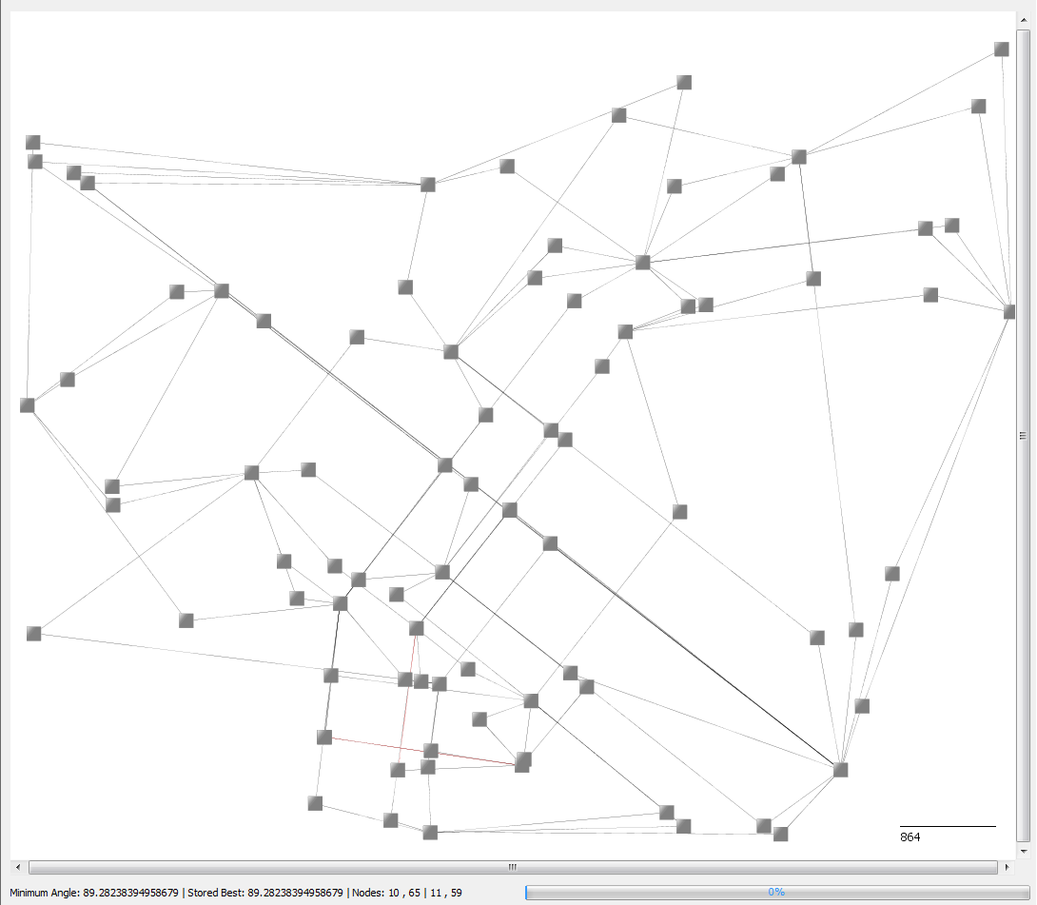
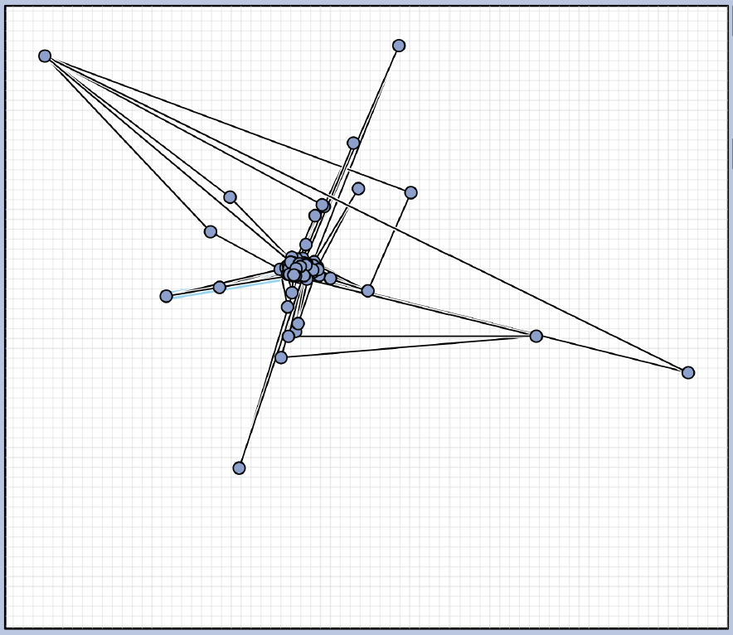
Graph 8
Current best 89.28°
Contest best last year 84.95°

Slide 21
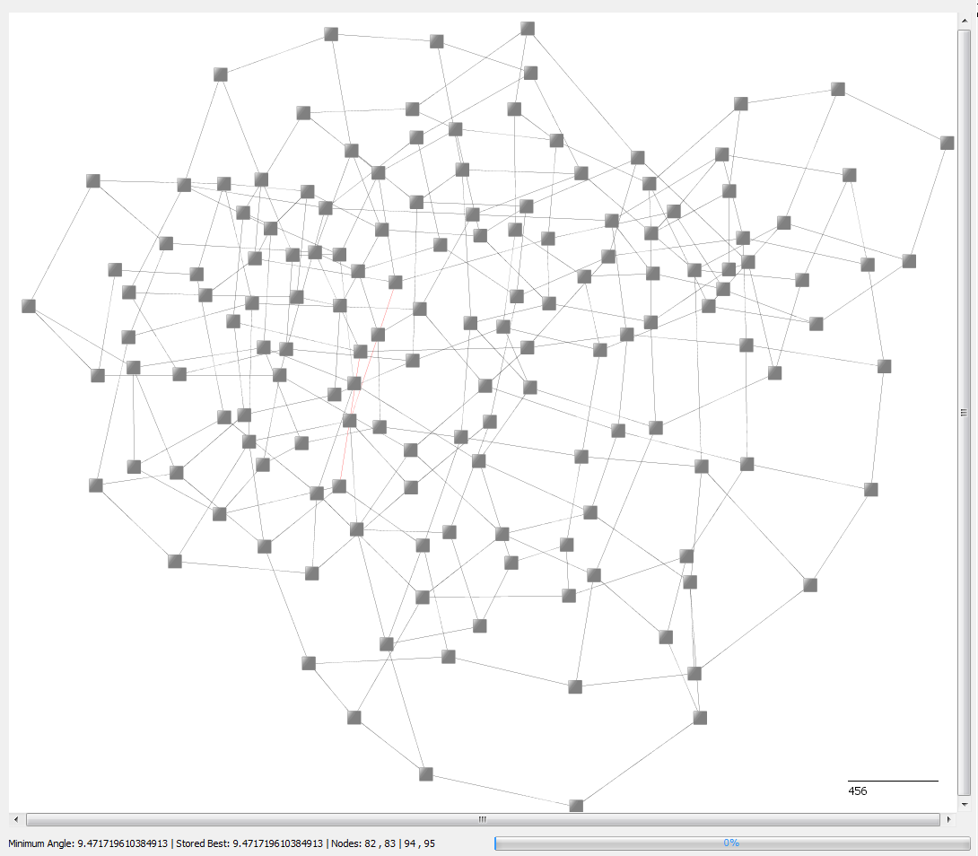
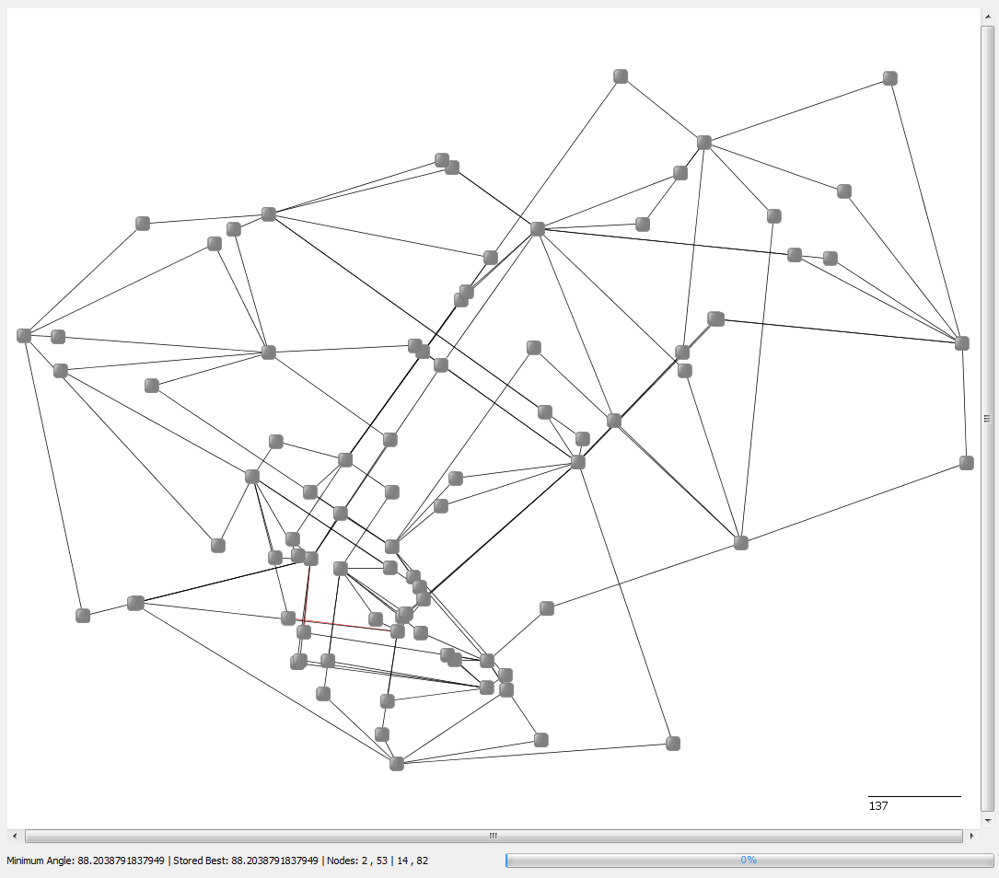
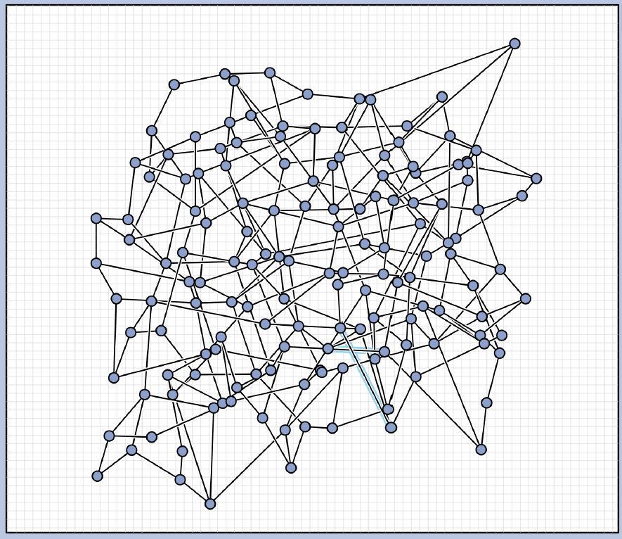
Graph 9
Current best 88.2°
Contest best last year 59.885

Slide 22
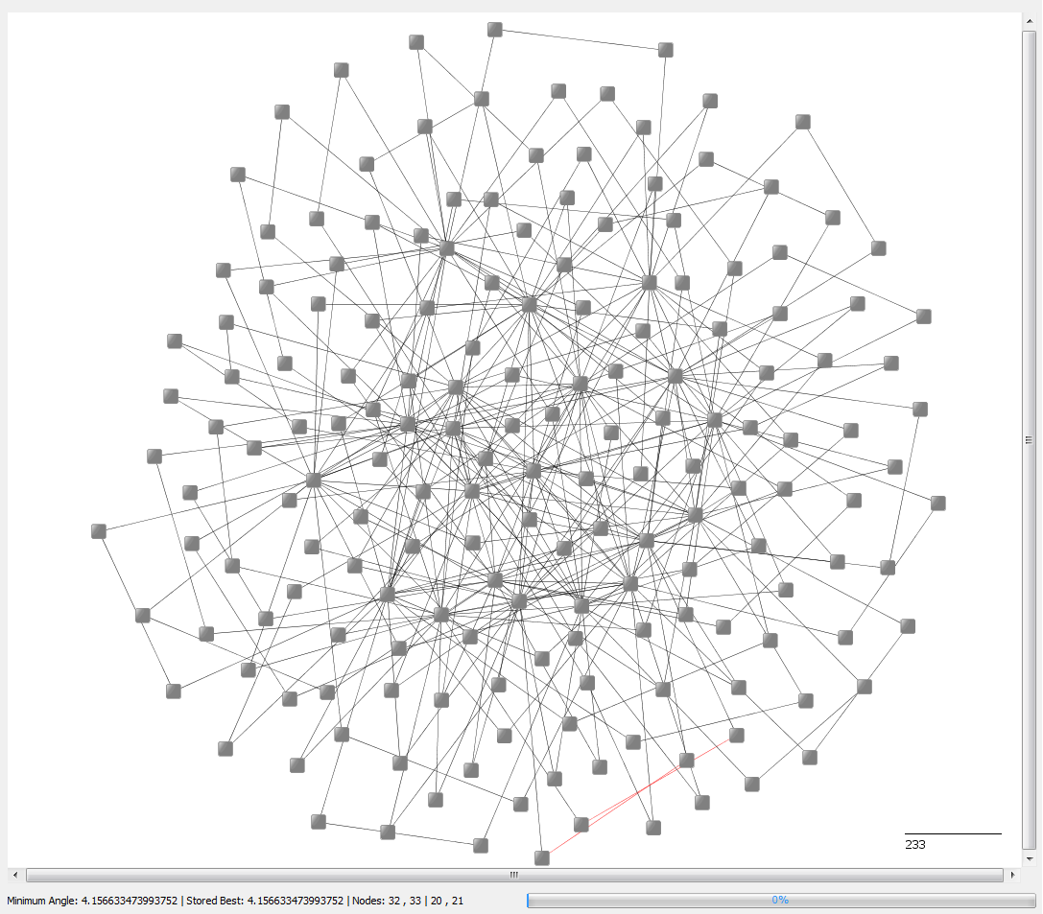
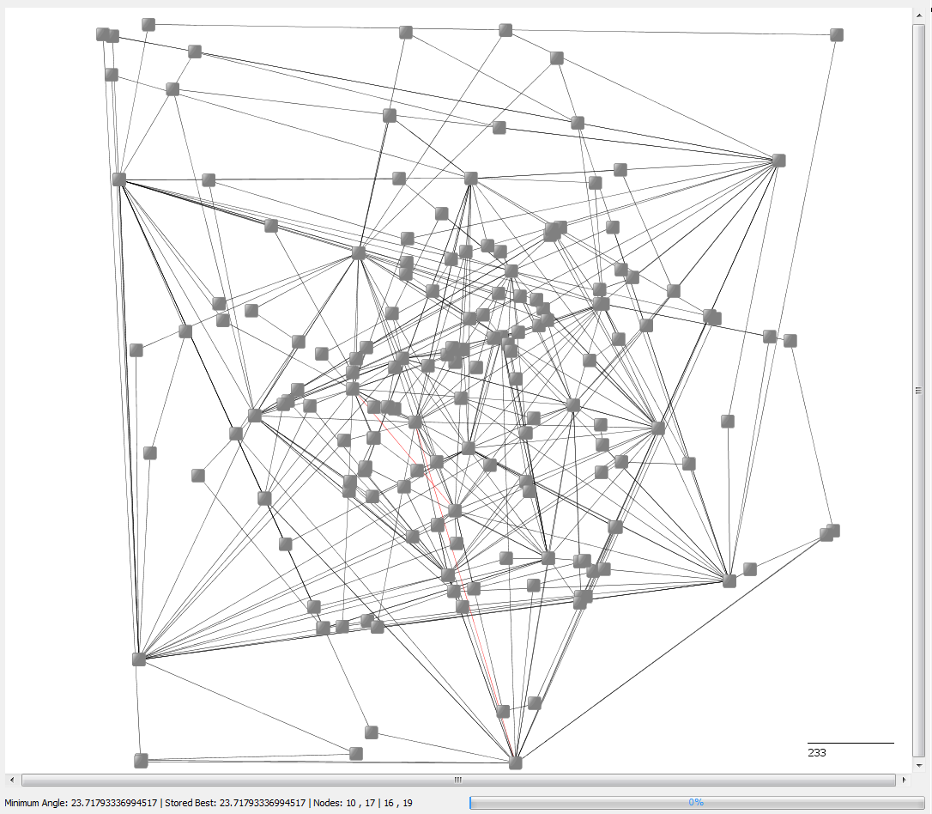
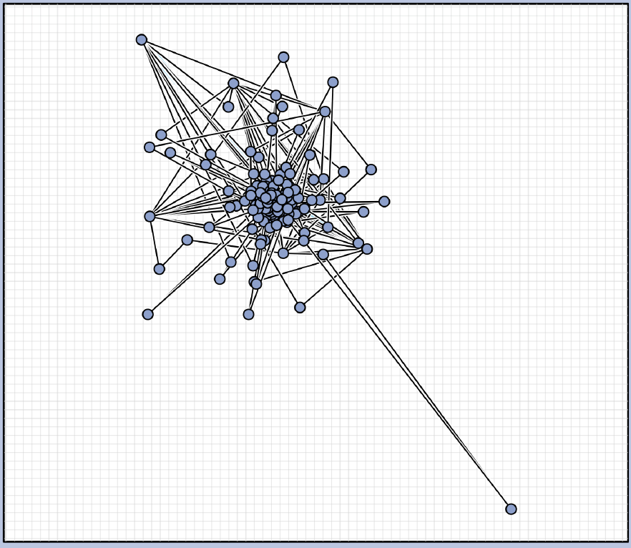
Graph 10
Current best 23.72°
Contest best last year 20.978°

Slide 23
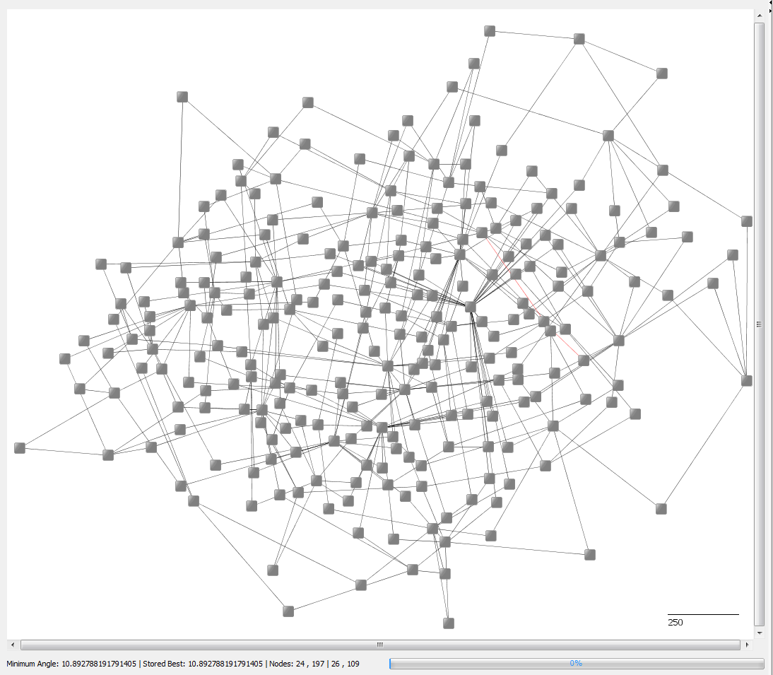
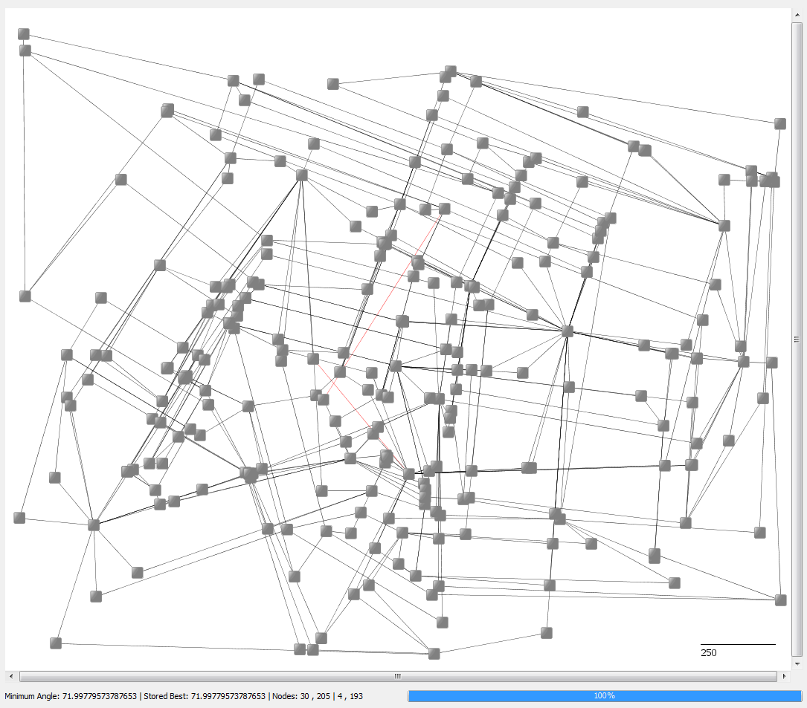
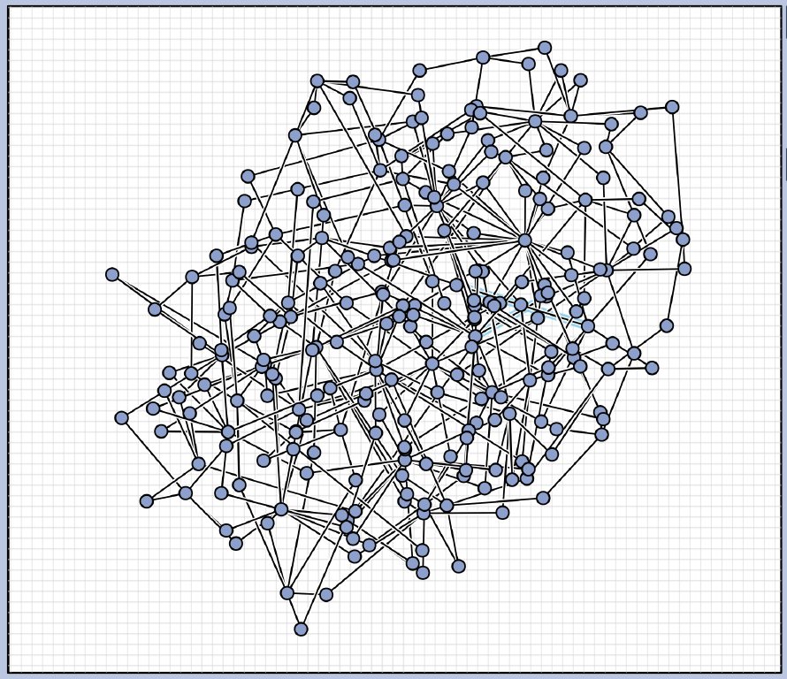
Graph 11
Current best 72°
Contest best last year 46.684°

Slide 24
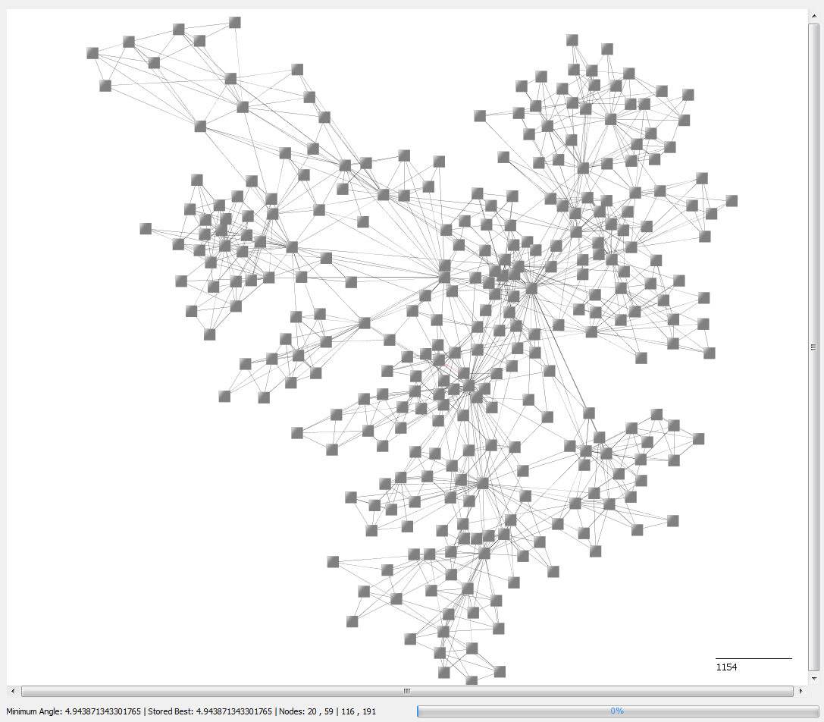
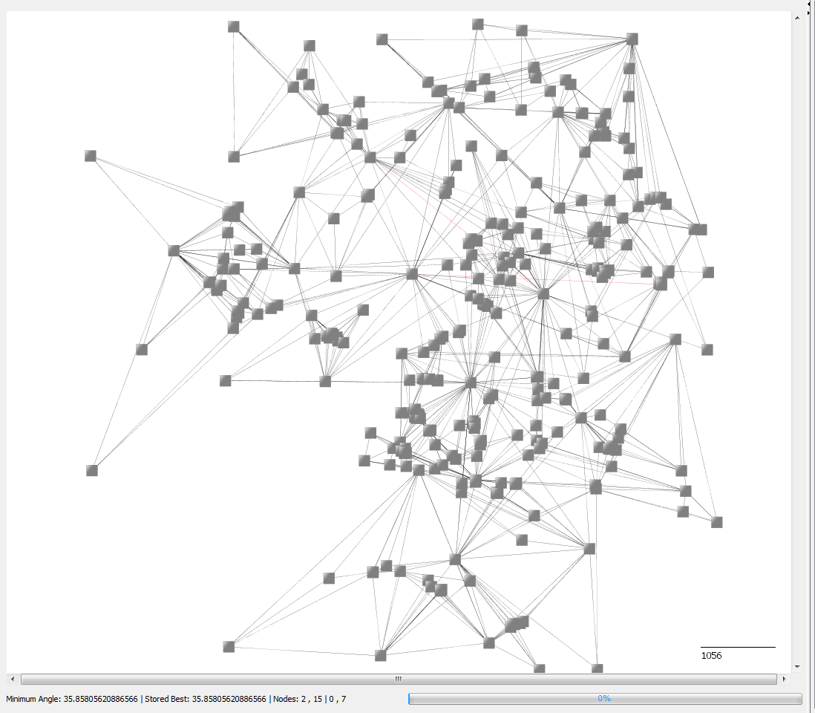
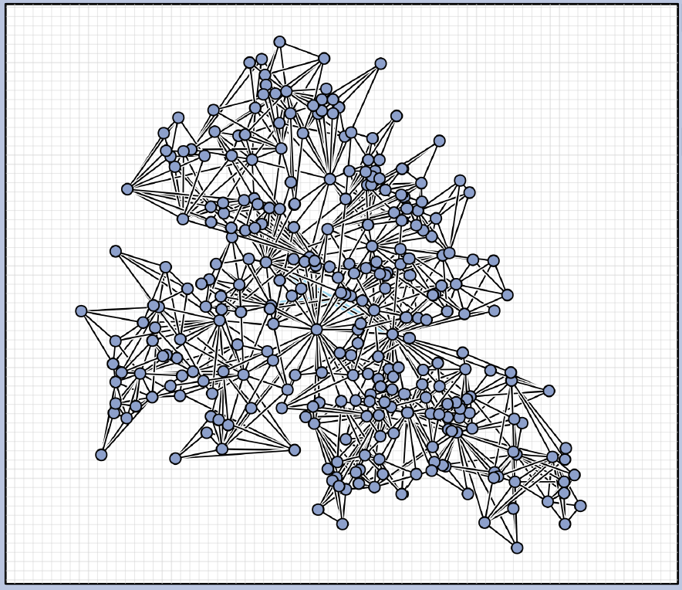
Graph 12
Current best 35.86°
Contest best last year 36.47°

Slide 25
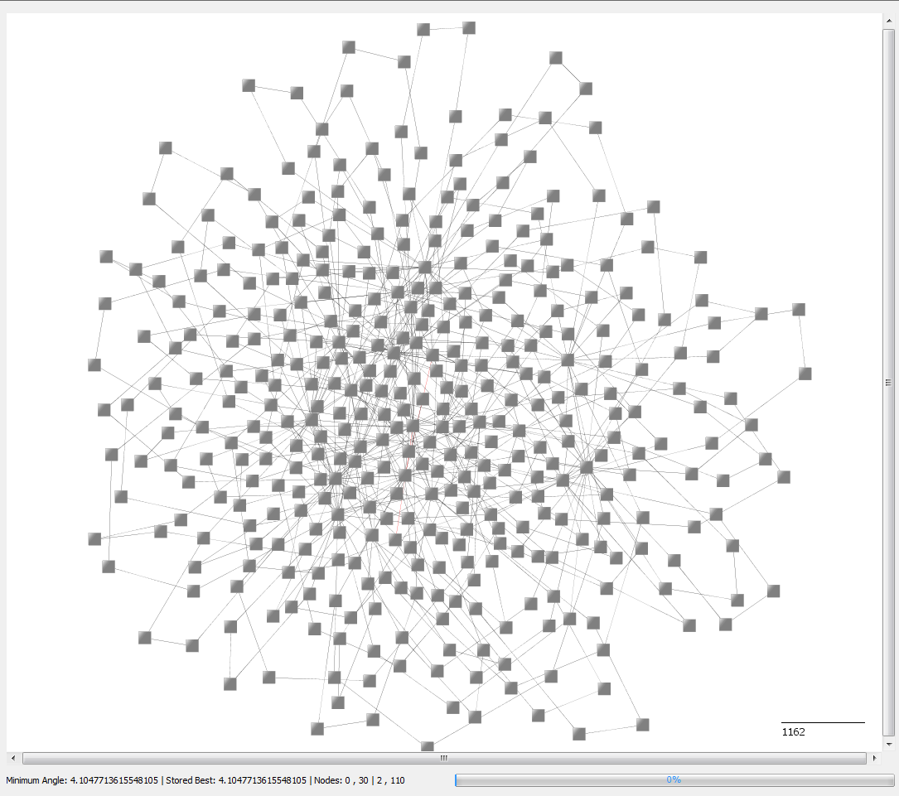
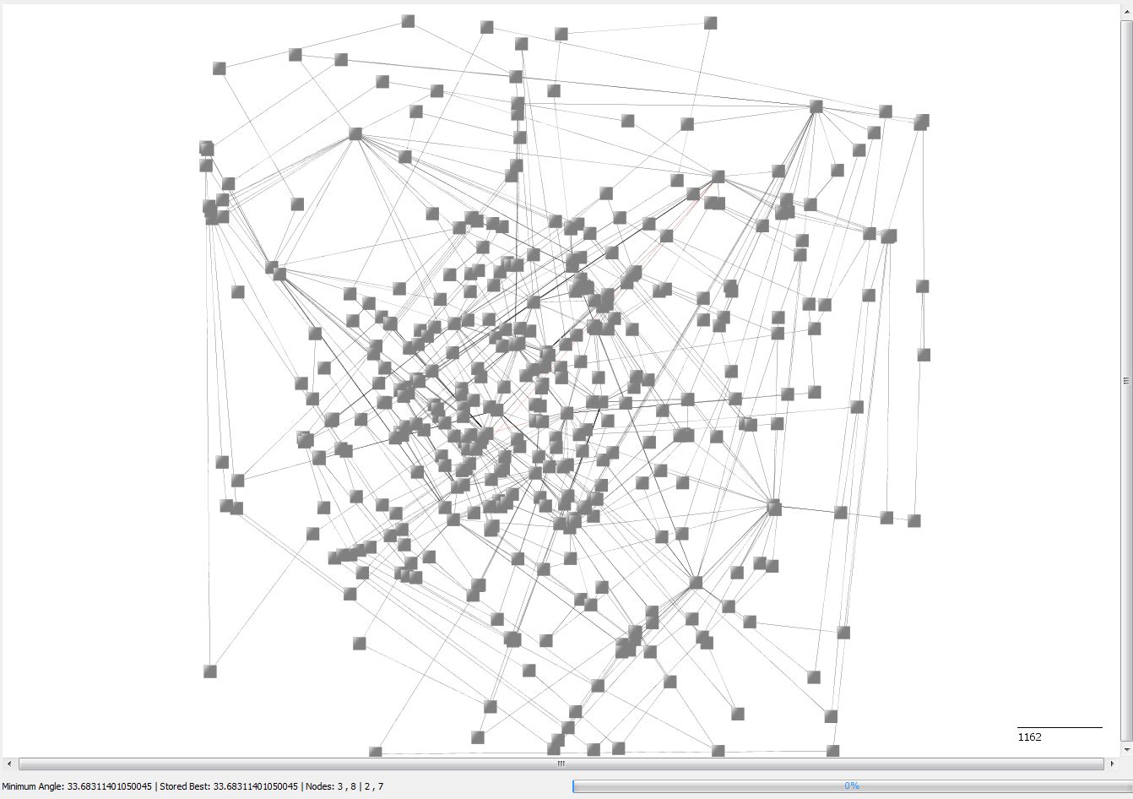
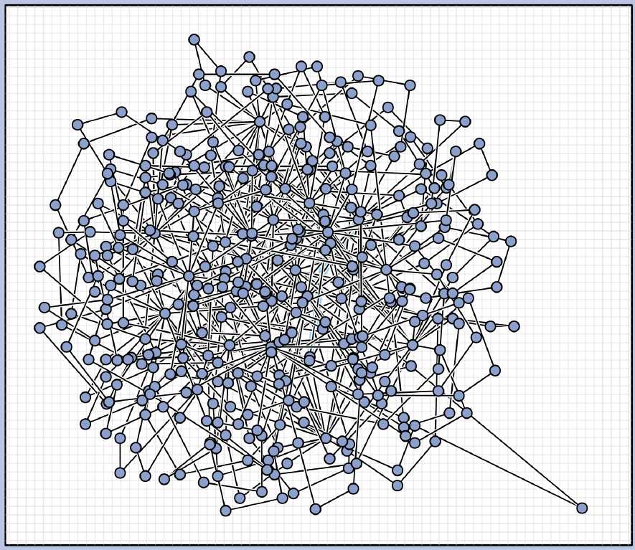
Graph 13
Current best 33.68°
Contest best last year 25.456°

Slide 26
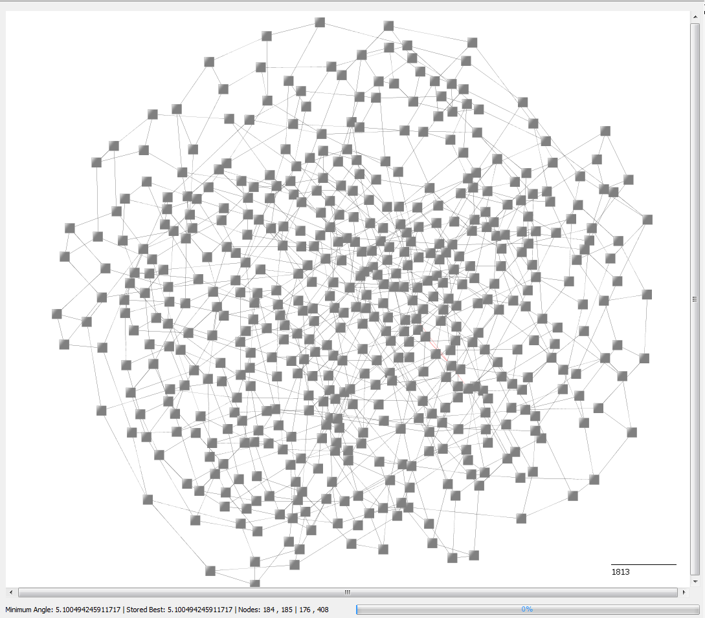
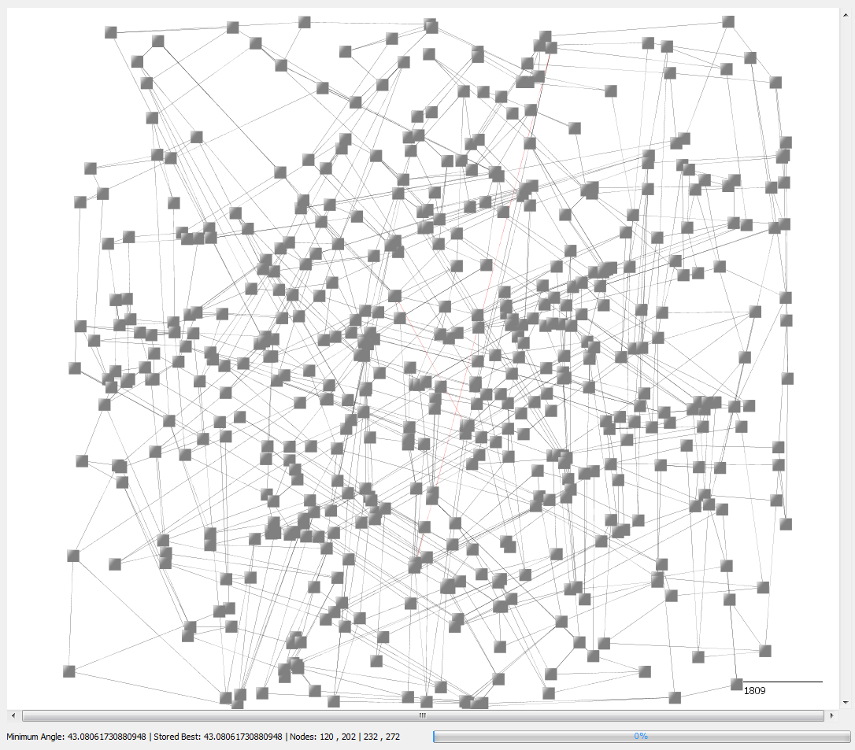
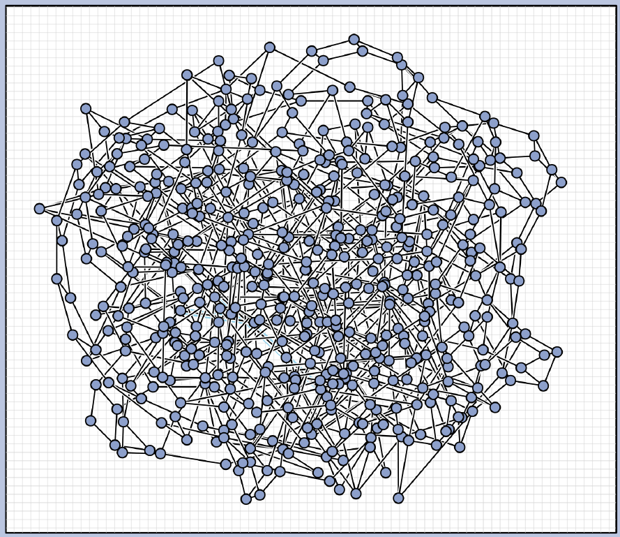
Graph 14
Current best 43.08°
Contest best last year 33.52°

Slide 27
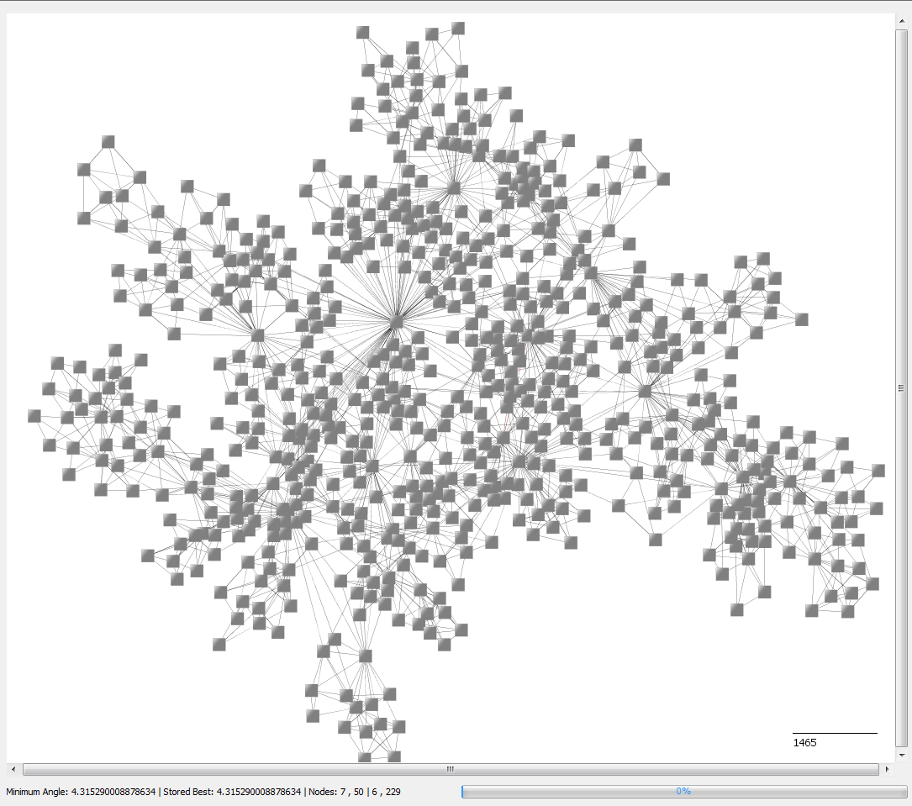
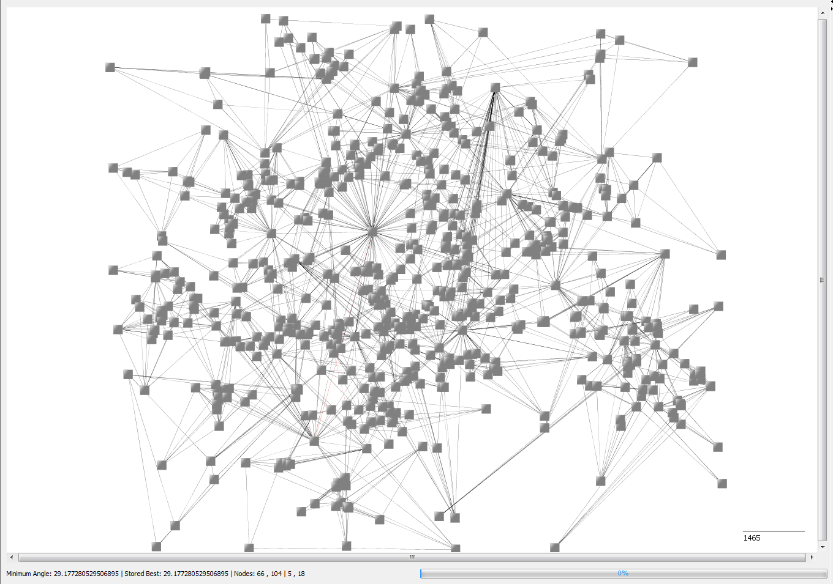

Graph 15
Current best 29.18°
Contest best last year 20.512°

Slide 28



Graph 16
Current best 26.12°
Contest best last year 19.835°

Slide 29
Results Summary

